Slide 1

Who owns data and does it matter?
image;www.pixelstalk.net/data-hd-background/

Slide 2

-Data
-Current concepts of data ownership
-And beyond

Slide 3
Data science is one of the fastest growing fields in the world.
-Recent estimates show approximately 90% of the data that exists in the world today has been created over the last two years alone. (Oct 2017- https://sciencetrends.com/problems-data-ownership-data-security/)
-Much of this data is created by everyday people, through posts on social media, emails, and instant messages. With the explosion of the data science field, the question of who has ownership and access to this data is becoming increasingly relevant.
-French journalist Judith Duportail made use of a European Union data privacy law to request a copy of the consumer data that dating app Tinder had collected on her. Duportail received 800 pages containing a massive amount of information about her including hobbies, occupation, her “likes” on Facebook, romantic and sexual preferences, musical tastes, geolocation, and more.
-While users of such sites typically agree to terms and conditions, what percentage of people bother to read these? Do they understand what they are signing? And the benefits corporations derive from their data generation?

Slide 4
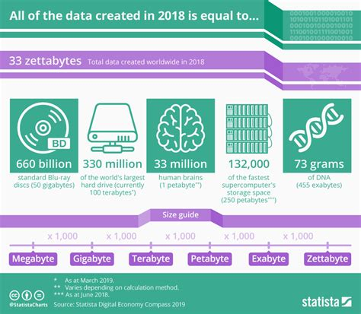
https://infographic.statista.com/normal/chartoftheday_17723_the_data_created_last_year_is_equal_to_n.jpg

Slide 5
Google, Facebook, Amazon, Spotify, Instagram, Tiktok, YouTube
-Data harvesters , locating and harnessing your data for the purposes of profit.
-In the current legal landscape, you probably don’t own the data that is collected about you.
-Modern legal concepts of privacy and copyright are usually insufficient to deal with the concept of data ownership. As a result, there is no legal concept which defines you as the owner of information about your life. Certain laws do guarantee a consumer’s right to access data about them, however. The EU provision that allowed Duportail to request a copy of her data from Tinder is an example of these laws-GDPR
-The GDPR's primary aim is to give control to individuals over their personal data and to simplify the regulatory environment for international business by unifying the regulation within the EU. However, in the US, as Tufecki notes, data privacy is not tightly regulated.
Even if legal precedence for data ownership is currently insufficient, and ethical case for allowing private citizens access their data can easily be made. If people can access the data that has been collected about them, they have the potential to learn interesting things about their lifestyles and preferences. As was revealed to Duportail when she requested a copy of her data from Tinder, the ability to analyze aggregated data about our lives can lead to powerful insights about ourselves. It would seem unfair to withhold this opportunity from people when they are the source of the data in the first place.

Slide 6
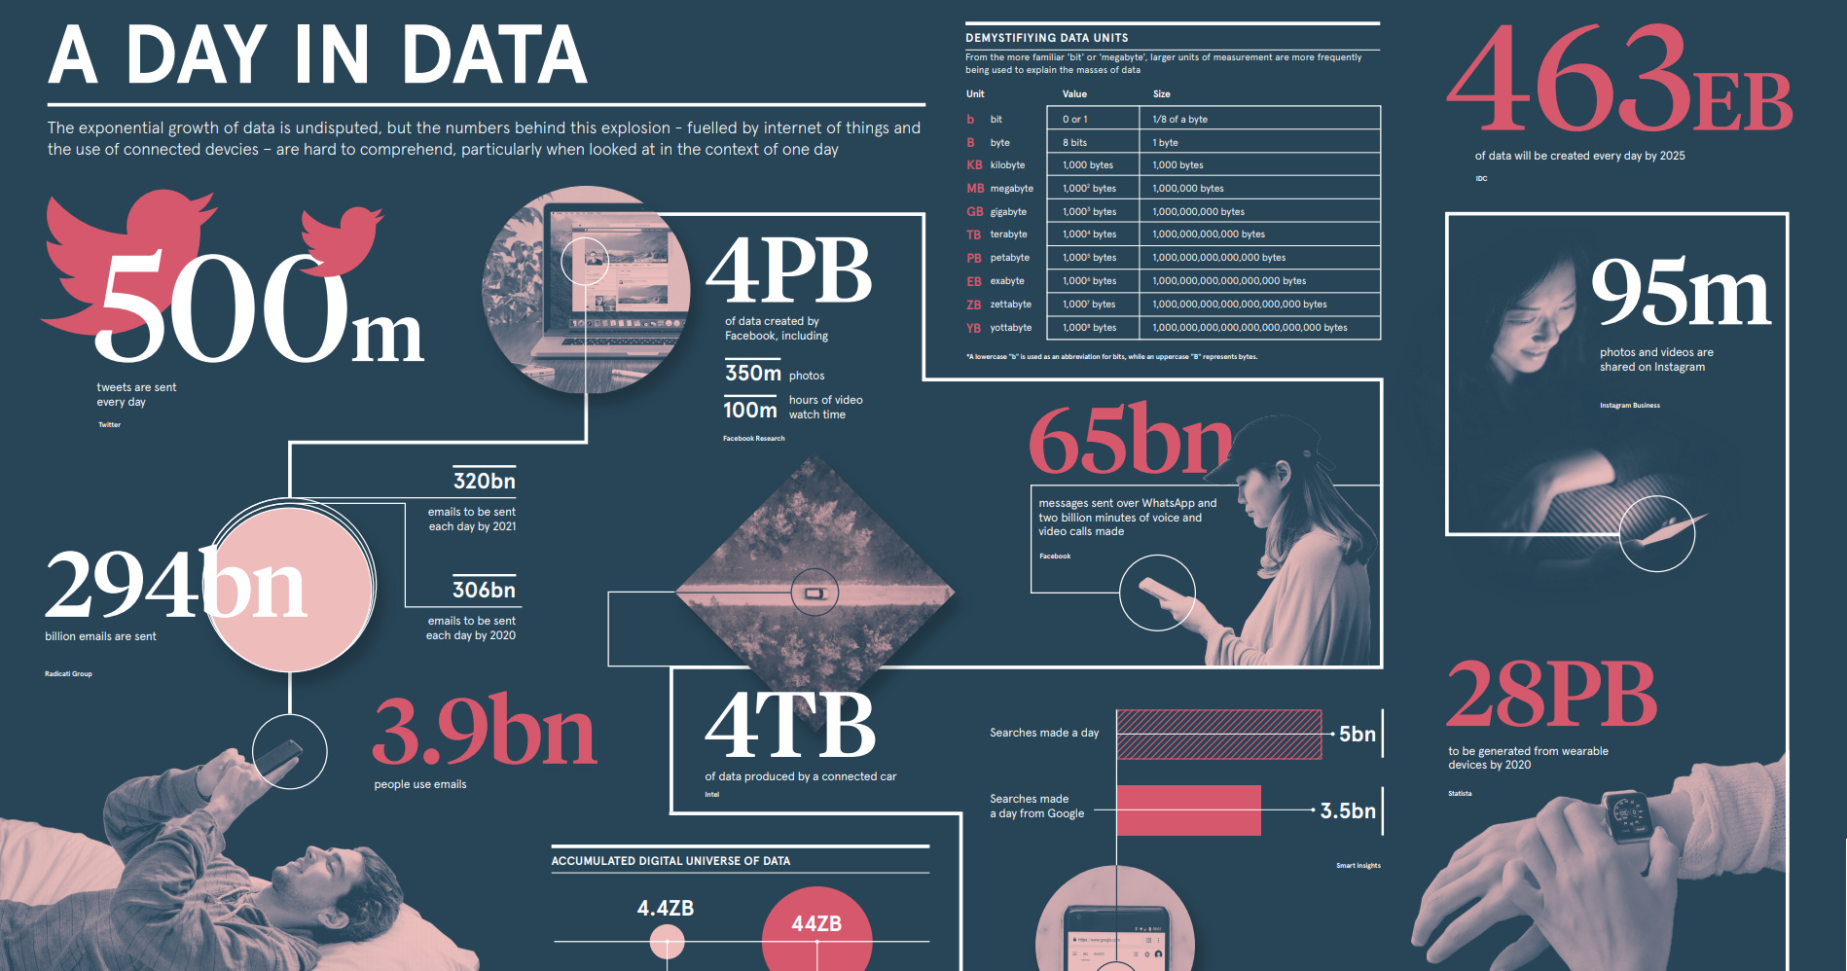
https://2oqz471sa19h3vbwa53m33yj-wpengine.netdna-ssl.com/wp-content/uploads/2019/04/day-in-data-share.jpg

Slide 7
Control
-Held by companies- Google, Spotify, Facebook, Instagram Hotmail etc but content still owned by you,
Although the company’s terms of service are emphatic that Facebook users “own” the info they post, a dive into Facebook’s separate data policy takes a broader view.It says information will be shared with business partners and with entities “conducting academic research and surveys.” That’s the back door that Kogan climbed through.“These partners must adhere to strict confidentiality obligations in a way that is consistent with this data policy and the agreements we enter into with them,” Facebook says. But the Cambridge Analytica case shows that once information gets into the wild, there are few effective means of limiting where it goes.
https://www.latimes.com/business/lazarus/la-fi-lazarus-facebook-cambridge-analytica-privacy-20180320-story.html
-Held by ourselves as aggregates- Digime- individuals take control of their data and privately share with data-driven apps and services
-Held by communities- data co-ops as aggregators-Alex ‘Sandy’ Pentland- MIT Human Dynamics Lab, Head of Big Data and Information privacy
https://www.techrepublic.com/article/mit-professor-wants-to-shift-power-to-the-people-by-building-local-data-collectives/

Slide 8
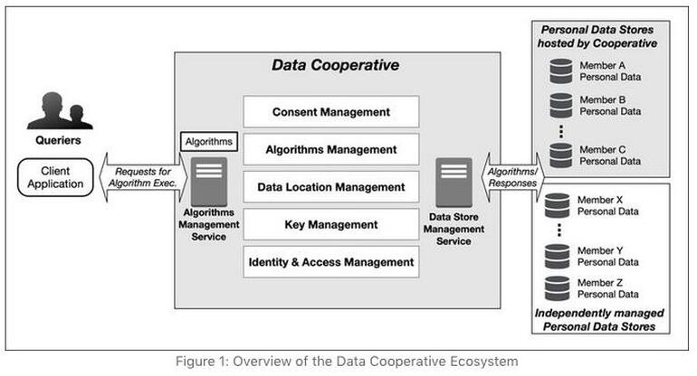
Data Co-operative

Slide 9
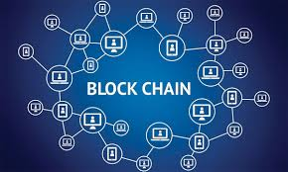
Image: https://blogs.iadb.org/caribbean-dev-trends/en/blockchain-technology-explained-and-what-it-could-mean-for-the-caribbean/

Slide 10
Blockchain as an answer for control?
-Oct 22, 2020- https://www.techopedia.com/who-owns-the-data-in-a-blockchain-application-and-why-it-matters/2/33461
-Google, Facebook, and other major companies that engaged in business activities relying predominantly on personal data are heavily criticized for unfairly benefiting from the personal data of their users. Points of criticism include, but are not limited to:
Insufficient control their users have over personal information., Risk of re-identification of anonymous personal data., Lack of valid consent given by their users.
By preventing any single entity from controlling users’ personal information, blockchain removes the ability of these entities to sell or monetize your personal data.
Instead, transaction data could be encrypted using a unique digital signature of the user (a private key), opening up the potential for users to monetize by decrypting parts of their own transaction history and personal data for advertisers or brands.
There are a number of reasons for businesses to incorporate blockchain technology into their offerings, including lower costs, added security, and its unique ability to leverage crypto-economics to incentivize customer behavior.
The design of new blockchain platforms and their accompanying ecosystems will likely govern the interpretation of property rights on a blockchain. The use of blockchain can allow for a user to decide how and when their data is utilized and to be compensated for such use.
While such compensation likely will not be life-changing, Facebook was earning on average $20.21 per user in 2017, ownership of our own data, and the ability to police its use is no small matter.

Slide 11
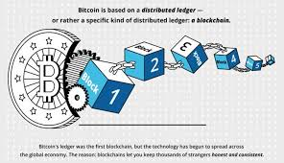
The tokenization of ecosystems created atop a public blockchain allows for incentivization mechanisms to be built in, allowing for compensation for the release of personal data, released with your permission.
In such ecosystems, individuals would have ownership of their personal data until they grant a third party access, at a price. (Read also: An Introduction to Blockchain Technology.)
It should be noted that blockchain companies allowing users to control and benefit from their personal data already exist. One such platform is digi.me. Julian Ranger, one of the developers of the platform, described digi.me as follows:
“We are building a worldwide decentralized personal data grid owned by the individuals themselves. We are not building services on that data – we are the librarian for the individual, and their postman when sharing data.”

Slide 12
A new type of relationship with data?
-data ownership not in terms of ideas around property but a version of copyright
-data is the story of a person’s life
-Writers are paid for creating stories and organisations then distribute these stories and benefit from the information writers put to paper.
-Where individuals or companies profit from non synthetic data, these data-creators should share in this profit as without them would the data and the benefit derived from it exist?
-Data aggregation is reinventing the wheel. Potentially cumbersome and limiting for the purposes of data analysis, investigation and commercial exploitation?
-Legislate the concept of a data-creator and this will redefine an individual’s relationship with all data-consumers/manipulators.

Slide 13

Questions?

Slide 14
References
https://thehill.com/opinion/technology/452874-who-should-own-your-digital-data
https://www.wired.com/insights/2014/02/owns-data/
https://www.inc.com/jeremy-goldman/how-companies-like-amazon-google-turn-data-into-a-competitive-advantage-how-you-can-too.html
https://winningtech.com/who-actually-owns-your-data/
https://www.bbc.co.uk/programmes/w3csxgpb
https://www.csoonline.com/article/3238189/who-owns-your-data.html
https://www.csoonline.com/article/3238189/who-owns-your-data.html
https://sciencetrends.com/problems-data-ownership-data-security/
https://www.techopedia.com/who-owns-the-data-in-a-blockchain-application-and-why-it-matters/2/33461
https://papers.ssrn.com/sol3/papers.cfm?abstract_id=3111047
https://www.techrepublic.com/article/mit-professor-wants-to-shift-power-to-the-people-by-building-local-data-collectives/
https://www.undatarevolution.org/data-revolution/

